Slide 1
CAMARA EdgeCloud Meeting 12th December

Slide 2
INSERT SUBHEADING
Agenda
How to progress towards a EdgeCloud MVP
Discussion on Application Vs Artifact
Other implementation details

Slide 3
How to progress towards a EdgeCloud MVP
Option1: Maintain a subapi separation similar to the current:
Discovery, TrafficInfluence (with canditates to v1.0.0), evolving simpleedgediscovery with additional methods.
Resource Management,Workload Orchestration (with no progress from initial update)
Option2: Merge MVP API proposal (PR 154 ) with currentsimple edgediscovery with extra optional parameters, maintaining Traffic Influence separated

Slide 4
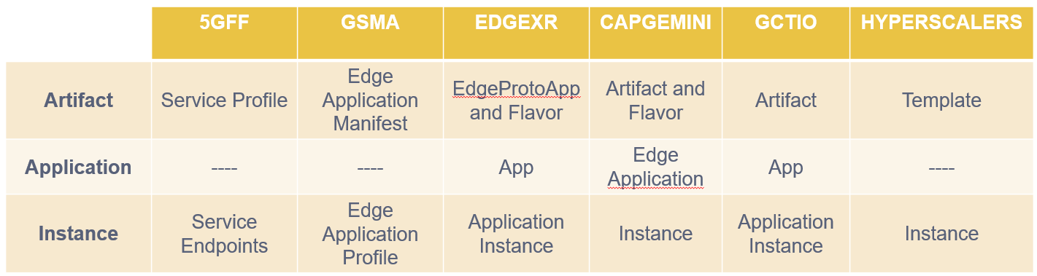
Discussion on Application Vs Artifact
Should we keep separate concepts for Artifact, Application or consider just an application Profile/Manifest like everything about how to deploy the application?
What is there in current contributions (5GFF, EdgeXR , Capgemini), definitions (GSMA) or others (Hyperscalers)
Any use cases that might not be covered for a App Manifest only approach?
Scanning files when uploading
Reuse artifact for more than one application?

Slide 5
Other implementation details
How will end user know the URI to connect to ? Review discussion in PR PR 159
Review of other topics from last comments in open pull requests

Slide 6
Backup

